Slide 1
Introduction to programming COSC 2511
Week 1
Introduction to Java & Programming Fundamentals
Notes:
Instructions
To create em dash above headline Same size and weight as the headline and set using a soft return. PC: Em dash (—): Alt+Ctrl+ - (minus) Mac: Em dash (—): Shift+Alt/Option+hyphen

Slide 2
Lecture Overview
Introduction to the Course
Why Java?
Overview of Programming Fundamentals
Algorithms
Creating a basic program

Slide 3
Tutorial Overview
Installing Java
Selecting an IDE
Writing Algorithms
Create your first program
Formatting Code
Escape Sequences
Commenting
Reflection Quiz

Slide 4
Welcome to Programming
Please familiarise yourselves with the following:
Course Announcements
Course Syllabus
Modules
Assessment Schedule

Slide 5
Why Java?
Java is easy to learn:
Java was designed to be easy to use and is therefore easy to write, compile, debug, and learn than other programming languages.
Java is object-oriented:
This allows you to create modular programs and reusable code.
https://www.ibm.com/docs/en/aix/7.1?topic=monitoring-advantages-java

Slide 6
Why Java?
Java is platform-independent:
One of the most significant advantages of Java is its ability to move easily from one computer system to another.
The ability to run the same program on many different systems is crucial to World Wide Web software, and Java succeeds at this by being platform-independent at both the source and binary levels.
Because of Java's robustness, ease of use, cross-platform capabilities and security features, it has become a language of choice for providing worldwide Internet solutions.
https://www.ibm.com/docs/en/aix/7.1?topic=monitoring-advantages-java

Slide 7
What’s different in Java?
Java compiler translates a program written in Java according to syntax rules into intermediate code called bytecode.
Bytecode for Java is like assembly code for some languages.
Bytecode is like machine code but machine independent. The bytecode can then run on any computer with a Java Virtual Machine, as shown below.

Slide 8
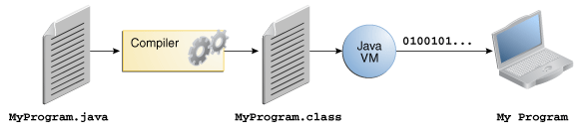
What’s different in Java?
Java Virtual Machine (JVM) is a software that interprets Java bytecode.
“Interprets” means that bytecode is translated (run) into human understandable output on execution.

Slide 9
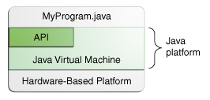
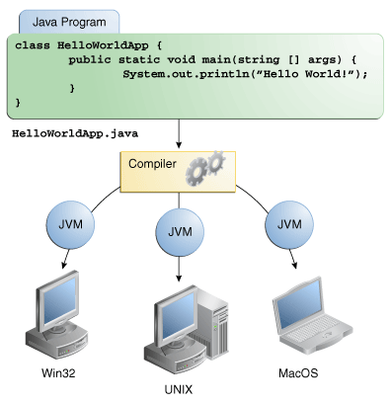
Java platform
JVM and API are parts of JRE – java runtime environment.
JRE is installed in any computer

Slide 10
Java source code
Most HLL (High Level Language) programs are written as text files in any text editor.
Programs in text format are called source code.
Java source code has an extension of .java
Source code
Compiler
bytecode
The Java interpreter reads the bytecode and executes it on a specific machine.
Welcome to Java!
bytecode
JVM(Interpreter)
Output
Unlike machine code Java bytecode is not tied to any particular machine. It can be run on any platform (Windows, Mac, Unix)

Slide 11
Steps in Program Development
Programming can be thought of as designing a solution to a problem.
The development of the solution follows specific steps, regardless of the programming language used.
Define the problem
Outline the solution
Develop the outline into an algorithm
Test the algorithm for correctness
Code the algorithm into a specific programming language
Run the program on the computer
Document and maintain the program

Slide 12
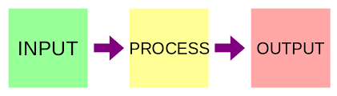
1. Define the Problem
To understand an analyze the problem, and design a suitable solution, the programmer will divide their task into three parts:
The inputs
The processing steps,
The desired outputs
These steps follow the IPO model

Slide 13
2. Outline the solution
After the problem has been defined, the programmer, may decide to break the problem up into smaller tasks or steps.
This outline may include:
The major steps involved
The order in which those steps occur (sequence)
Whether some steps may be repeated (repetition)
Whether some steps involve a choice between alternatives (selection)
Which information needs to be collected and stored (variables and constants)

Slide 14
3. Develop the outline into an algorithm
The solution outline developed in Step 2 is then expanded into an algorithm, but what is an algorithm?
An algorithm is a process or set of rules to be followed in problem solving operations – especially by a computer.
Basically, it is a plan for us to follow
If you cannot clearly explain the steps in plain language – why should the program work in computer language?

Slide 15
4. Test the algorithm for correctness
The purpose of testing the algorithm is to check that the program provides the solution to the problem.
We must ensure the following are checked:
Inputs: All information necessary is obtained and stored in the required format. (inputs)
Process: That the steps follow logically from one to another (sequence).
Process: That steps required to be repeated, will repeat, and if so, will eventually terminate (repetition)

Slide 16
Pseudo Code
Pseudo code is a detailed, yet easily readable version of code.
Pseudo code is great because you can use it to tell a story to those who are not adept in coding.
There is no standard syntax with pseudocode, so it is easily adaptable across many languages.

Slide 17
Pseudo code example 1
Let's look at how we write pseudo code for a tea making program with the simple example of making tea:
Boil water
Put teabag into cup
Pour Water into cup
Serve tea
…This seems a little light on. There are some steps missing that may not seem obvious to you, however you need to remember that when you write psudo code you are writing it for someone who has no understanding of code.

Slide 18
Pseudo Code example 1
Let's go back to our pseudo code and see how we could improve it:
Well before we boil the kettle, we need to fill it up with water. So, lets add this step in:
Fill Kettle with Water
Boil water
Put teabag into cup
Pour Water into cup
Serve tea

Slide 19
Pseudo Code example 1
There will always be a difficulty in determining how granular you should go.
This will depend on several factors including but not limited to:
Your understanding of the problem
The complexity of the problem
Knowing the abilities of those you are working with

Slide 20
Pseudo Code
As a starting point, it is important that you write your pseudo code to include all scenarios.
Computers do not assume anything, especially when we are writing code, so you need to anticipate all outcomes.
The programs we are starting with are simple and designed to teach you the fundamentals of programming, so your algorithms will be very straightforward initially.

Slide 21
Pseudo code example 2
Input three number (Program Name)
Greet user
Ask user for number1
Store number1
Ask user for number2
Store number2
Ask user for number3
Store number3
Total = number1 + number2 + number2
Print total
End

Slide 22
Flowcharts
Another way we can plan out our code is using flowcharts.
Flow charts provide end users with a visual narrative compared to pseudo code which it text-based.
Based on the example of making tea before, lets create a flowchart to plan out what our code will look like.
You can use Visio and use the Basic flowchart shapes:

Slide 23
Flowchart Symbols
Early use flowchart symbols
Other useful flowchart symbols
Start / End
Data Storage
Input / Output
Process
Document
Decision

Slide 24
Flowcharts Example 1
Start
Fill kettle
Boil Water
Place teabag
Pour water into mug
Serve tea
Stop

Slide 25
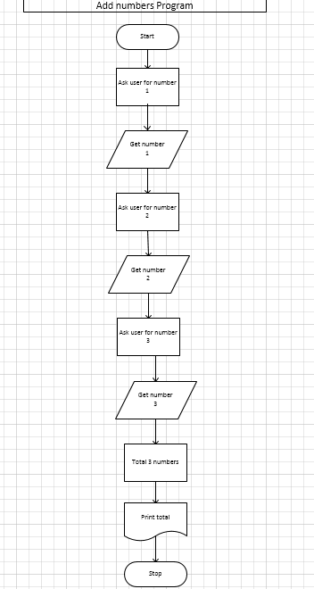
Flowcharts Example 2

Slide 26
Algorithmic Document
Something internally created here
Designed to simplify the design process of creating an algorithm especially for more complex programs

Slide 27
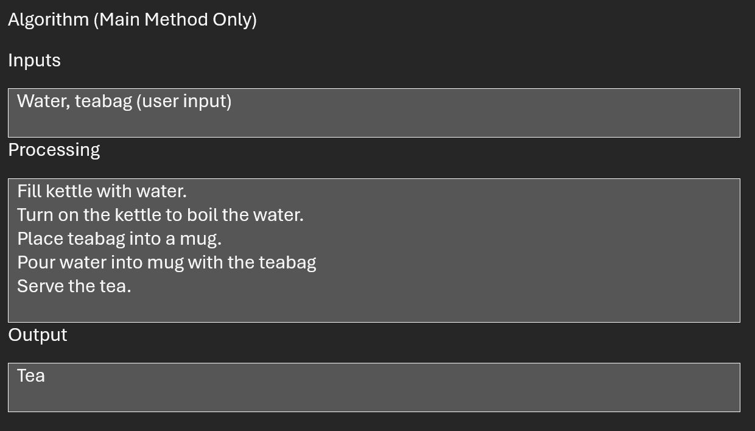
Algorithmic Document

Slide 28
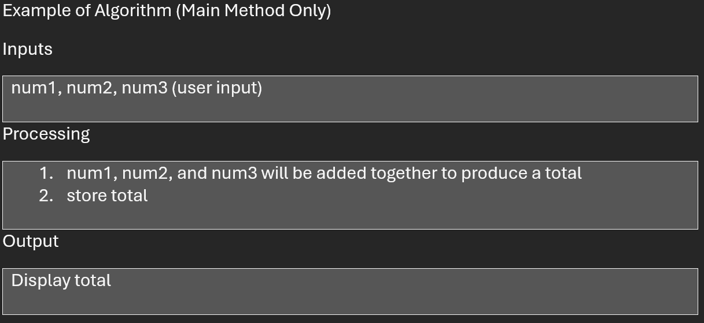
Algorithmic Document

Slide 29
5. Code the algorithm into a specific programming language
Write code in some programming language. In this course we will be using the Java programming language
Translate (compile/Interpret) the code into machine-readable form. Details vary slightly from one language to another.

Slide 30
6. Run the program on the computer
Execute the program.
If the program has been well–designed, the program should solve the problem before you.
Test the program. If the problem has not been solved, revisit the previous steps.
Is there a problem with your logic and design?
Is there a problem with your code and implementation?
Are there any errors in the application that may give you some clues as to where the errors lie?

Slide 31
What do we need?
Java Development Kit (JDK) contains the programs needed to compile (translate) and run Java code.
IDE’s (Integrated Development Environment’s) like Netbeans, Eclipse etc to write the code.
IDE’s are essentially text editors with a number of features to help in coding easier.

Slide 32
JDK
The Java Development Kit is needed to compile and run Java programs.
The Java Runtime Environment (JRE) is included and is needed to run the programs.
Java was developed by Sun Microsystems, but is now owned by Oracle Inc.
Get the JDK at http://www.oracle.com/technetwork/java/javase/downloads/index.html

Slide 33
Compile Hello.java
Compiling
To compile (translate) a java program we need javac.exe which is sitting in each computer in folder java/jdk<version>/bin
Running
To run a Java program we need java.exe which interprets/runs the program to get the output.

Slide 34
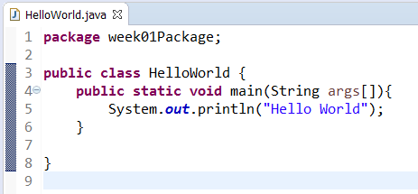

Program and output
Keyword class – must be lower case
Name of a class (HelloWorld) should start with an upper case letter
Braces (){}[] – make sure to use the right ones
Key word public is optional(more about this later). Although not strictly necessary, we generally add the keyword public to the start of the class. Once again lower case.

Slide 35
Main method
Now that we have the outline of the class, we need to put the outline of the main method inside it. A method is a block of code statements with a name. The main method is required in any class that can be directly executed.
main() method and comments
public static void main(String[] args){
//statements will go here
}
// A single line comment
/*
* A multiline comment
*
*/

Slide 36
Print statement
public class Hello{
public static void main(String[] args){
System.out.println("Hello");
}
}
public: other classes can access it.
static: other classes can call this method directly without first creating an object
void: the method won’t return any values.
Every main method has an argument called args which is defined as an array of strings

Slide 37
Flow of control
The three type of flow control statements in Java:
Sequence: Java executes one statement after the other in the order in which they are written.
Selection: if, if else, switch
Iteration: for, while, do while
We will progressively learn about these over the first third of the semester

Slide 38
Rules of naming
Names of classes, variables and methods
Can use letters, numbers, underscore, dollar characters _ and $, It cannot begin with a number and cannot have any spaces
Class names begin with an upper case letter
Variable and method names begin with a lower case letter
Constants are spelled all UPPER case

Slide 39
7. Document and maintain the program
Programming documentation is an ongoing process.
Documentation may be stored as external documentation and may be included as comments in your program.
Using a tool called JavaDoc you will be able to provide basic documentation for your program.
We will see more about this later in the second half of the semester.

Slide 40
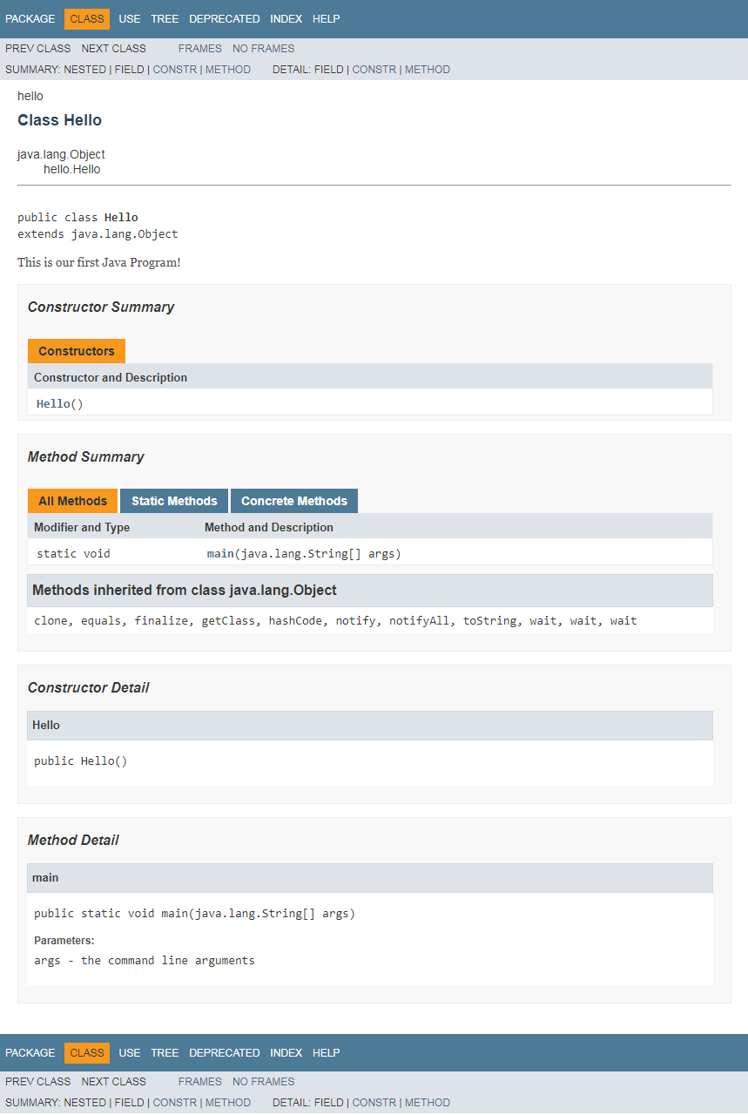
Javadoc Example

